Slide 1
UNIT – I
Back Propagation Networks

Slide 2
Back Propagation Network (BPN)
This learning algorithm is applied mutilayer feed-forward networks consisting of processing elements with continuous differentiable activation functions. The networks associated with back-propagation learning algorithm are also called back -propagation networks (BPNs). For a given set of training input-output pair, this algorithm provides a procedure for changing the weights in a BPN to classify the given input patterns correctly. The basic concept for this weight update algorithm is simply the gradient-descent method as used in the case of simple perceptron networks with differentiable units. This is a method where the error is propagated back to the hidden unit.

Slide 3
Back Propagation Network (BPN)
The aim of the neural network is to train the net to achieve a balance between the net's ability to respond (memorization) and its ability to give reasonable responses to the input that is similar but not identical to the one that is used in training (generalization). The back-propagation algorithm is different from other networks in respect to the process by which the weights are calculated during the learning period of the network. The general difficulty with the multilayer perceptrons is calculating the weights of the hidden layers in an efficient way that would result in a very small or zero output error. When the hidden layers are inceased the network training becomes more complex.

Slide 4
Back Propagation Network (BPN)
To update weights, the error must be calculated. The error, which is the difference between the actual (calculated) and the desired (target) output, is easily measured at the output layer. It should be noted that at the hidden layers, there is no direct information of the error. Therefore, other techniques should be used to calculate an error at the hidden layer, which will cause minimization of the output error, and this is the ultimate goal. The training of the BPN is done in three stages (I) the feed-forward of the input training pattern, (II) the calculation and back-propagation of the error, and (III) updation of weights.

Slide 5
Back Propagation Network (BPN)
The testing of the BPN involves the computation of feed-forward phase only. There can be more than one hidden layer (more beneficial) bur one hidden layer is suffcient.

Slide 6
Architecture
A back-propagation neural network is a multilayer, feed-forward neural network consisting of an input layer, a hidden layer and an output layer. The neurons present in the hidden and output layers have biases, which are the connections from the units whose activation is always 1. The bias terms also acts as weights. The direction of information flow for the feed-forward phase. During the back-propagation phase of learning, signals are sent in the reverse direction.
The inputs sent to the BPN and the output obtained from the net could be either binary (0, 1) or bipolar ( -1, + 1). The activation function could be any function which increases monotonically and is also differentiable.

Slide 7
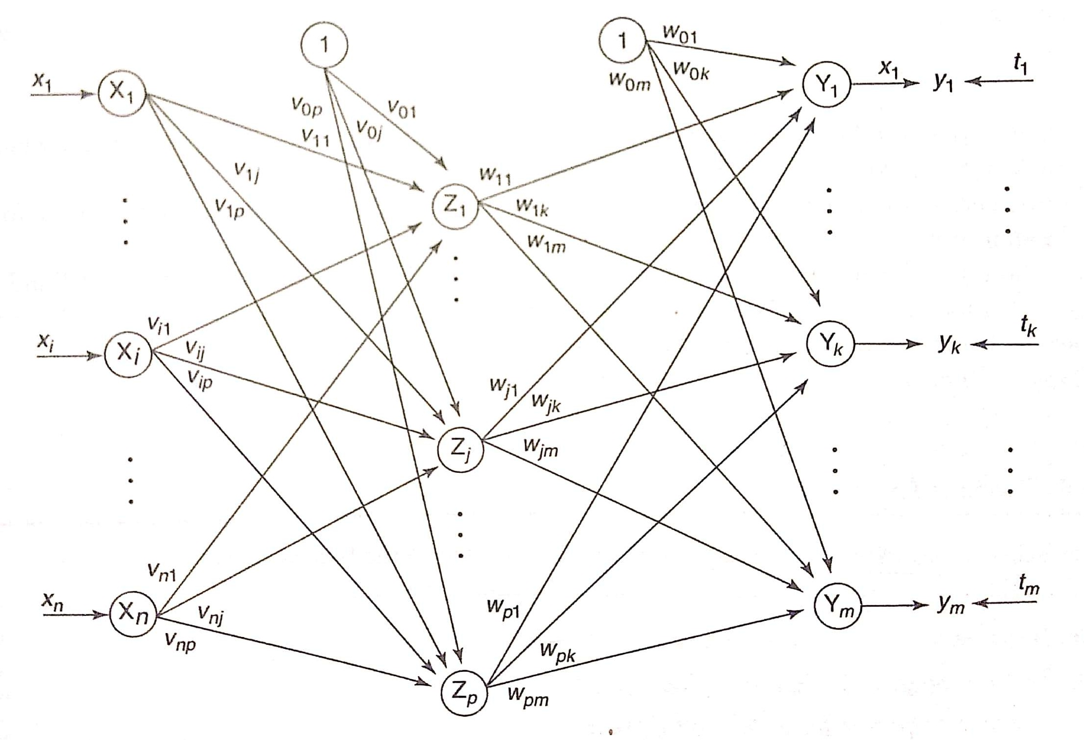

Slide 8

Flowchart for Training Process
The terminologies used in the flowchart and in the training algorithm are as follows:
x = input training vector (x₁,…….x_{i} ,…….x_{n})
t = target output vector (t₁,…….t_{k} ,…….t_{m})
α = Learning rate parameter
x_{i} = Input unit i
v_{0j} = bias on jth hidden unit
w_{0k} = bias on kth output unit
z_{j} = hidden unit j. The net input to z_{j} is
z_{inj} = v_{0j} +
and the output is
z_{j} = f (z_{inj} )

Slide 9

Flowchart for Training Process
y_{k} = hidden unit k. The net input to y_{k} is
y_{ink} = w_{0k} +
and the output is
y_{k} = f ( y_{ink} )
δ_{k} = error correction weight adjustment for w_{jk} that is due to an error at output unit y_{k} which is back-propagared to the hidden unit that feed into unit y_{k} .
δ_{j} = error correction weight adjustment for v_{ij} that is due to the back- propagation of error to the hidden unit z_{j} .
The commonly used activation functions are binary sigmoidal and bipolar sigmoidal activation functions. These functions are used in the BPN because of the following characteristics: (i) continuity; (ii) differentaibility (iii) nondecreasing monotony
The range of binary sigmoid is from 0 to 1, and for bipolar sigmoid it is from -1 to + 1.

Slide 10
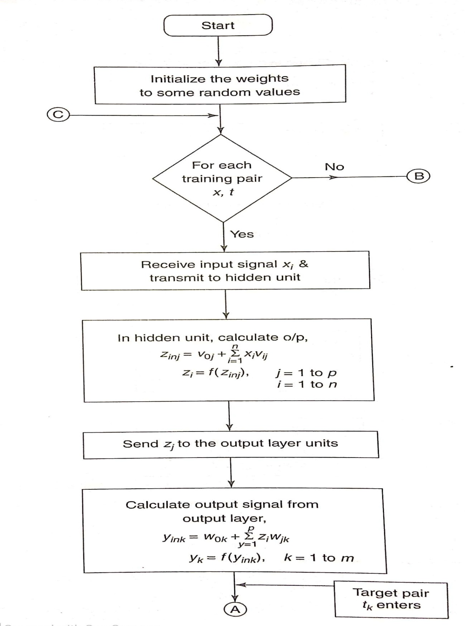

Slide 11
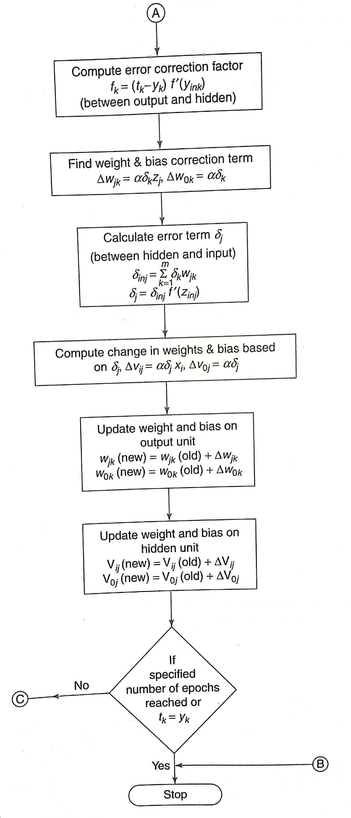

Slide 12
Training Algorithm
The error back-propagation learning algorithm can be outlined in the following algorithm:
Step 0: Initialize weights and learning rate (take some small random values).
Step 1: Perform Steps 2-9 when stopping condition is false.
Step 2: Perform Steps 3-8 for training pair.
Feed- forward phase (Phase I)
Step 3: Each input unit receives input signal x_{i} and sends it to the hidden unit (i = 1 to n)
Step 4: Each hidden unit z_{j} (j = 1 to p) sums its weighted input signals to calculate net input:
z_{inj} = v_{0j} +
Calculate output of the hidden unit by applying its activation functions over z_{inj} (binary or bipolar sigmoidal activation function):
z_{j} = f (z_{inj} )

Slide 13
and send the output signal from the hidden unit to the input of output layer units.
Step 5: For each output unit y_{k}(k = 1 to m),calculate the net input:
y_{ink} = w_{0k} +
and apply the activation function to compute output signal
y_{k} = f ( y_{ink} )
Back-propagation of error (Phase II)
Step-6: Each output unit y_{k} (k = 1 to m) receives a target pattern corresponding to the input training pattern and computes the error correction term:
δ_{k} = ( t_{k} – y_{k} ) f' (y_{ink} )
On the basis of the calculated error correction term, update the change in weights and bias:
∆ w_{jk} = α δ_{k} z_{j} ; ∆ w_{0k} = α δ_{k}
Also, send δ_{k} to the hidden layer backwards.

Slide 14
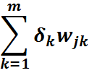
Step 7: Each hidden unit (z_{j} ,j = 1 to p) sums its delta inputs from the output units:
δ_{inj} =
The term δ_{inj} gets multiplied with the derivative of f(z_{inj}) to calculate the error term:
δ_{j} = δ_{inj} f' (z_{inj} )
On the basis of the calculated δ_{j} , update the change in weights and bias:
∆ v_{ij} = α δ_{j} x_{i} ; ∆ v_{0j} = α δ_{j}
Weight and bias updation (Phase III)
Step 8: Each output unit (y_{k}, k = 1 to m) updates the bias and weights:
w_{jk} (new) = w_{jk} (old) + ∆ w_{jk}
w_{0k} (new) = w_{0k} (old) + ∆ w_{0k}
Each hidden unit (z_{j}, j = 1 to p) updates the bias and weights:

Slide 15
v_{ij} (new) = v_{ij} (old) + ∆ v_{ij}
v_{0j} (new) = v_{0j} (old) + ∆ v_{0j}
Step 9: Check for the stopping condition. The stopping condition may be certain number of epochs reached or when the actual output equals the target output.

Slide 16
Learning Factors of Back-Propagation Network
Initial Weights:- The ultimate solution may be affected by the initial weights of a multilayer feed-forward network. They are initialized at small random values. The choice of the initial weight determines how fast the network converges. The initial weights can not be very high because the sigmoidal activation function used here may get saturated from the beginning itself and the system may be stuck at a local minima or at a very flat plateau at the starting point itself.
Learning Rate (α):- The learning rate (α) affects the convergence of the BPN. A larger value of α may speed up the convergence but might result in overshooting, while a smaller value of a has vice-versa effect.

Slide 17
Learning Factors of Back-Propagation Network
Momentum Factor:- The momentum factor is denoted by η ∈ [0, 1] and the value of 0.9 is often used for the momentum factor. Also, this approach is more useful when some training data are very different from the majority of data. A momentum factor can be used with either pattern by pattern updating or batch-mode updating. In case of batch mode, it has the effect of complete averaging over the patterns. Even though the averaging is only partial in the pattern-by-pattern mode, it leaves some useful information for weight updation.
Generalization:- The best network for generalization is BPN. When there are many trainable parameters for the given amount of training data, the network learns well but does not generalize well. This is usually called overfitting or overtraining. One solution to this problem is to monitor the error on the test set and terminate the training when the error increases.

Slide 18
Learning Factors of Back-Propagation Network
Number of Training Data:- The training data should be sufficient and proper. There exists a rule of thumb, which states the training data should cover the entire expected input space, and while training, training-vector pairs should be selected randomly from the set.
Number of Hidden Layer Nodes:- If there exists more than one hidden layer in a BPN, then the calculations performed for a single layer are repeated for all the layers and are summed up at the end. In case of all multilayer feed-forward networks, the size of a hidden layer is very important. The number of hidden units required for an application needs to be determined separately. The size of a hidden layer is usually determined experimentally.

Slide 19
Advantages of Back Propagation Network
Back propagation is fast ,simple and easy to program.
It has no parameter to tune apart from the number of inputs.
It is a flexible method as it does not require prior knowledge about the network.
It is a standard method that generally works well.
It does not need any special mention of the features of the function to be learned.

Slide 20
Applications of Back Propagation Network
The neural network is trained to express each letter of a word and a sentence.
It is used in the field of speech recognition.
It is used in the field of character and face recognition.

Slide 21
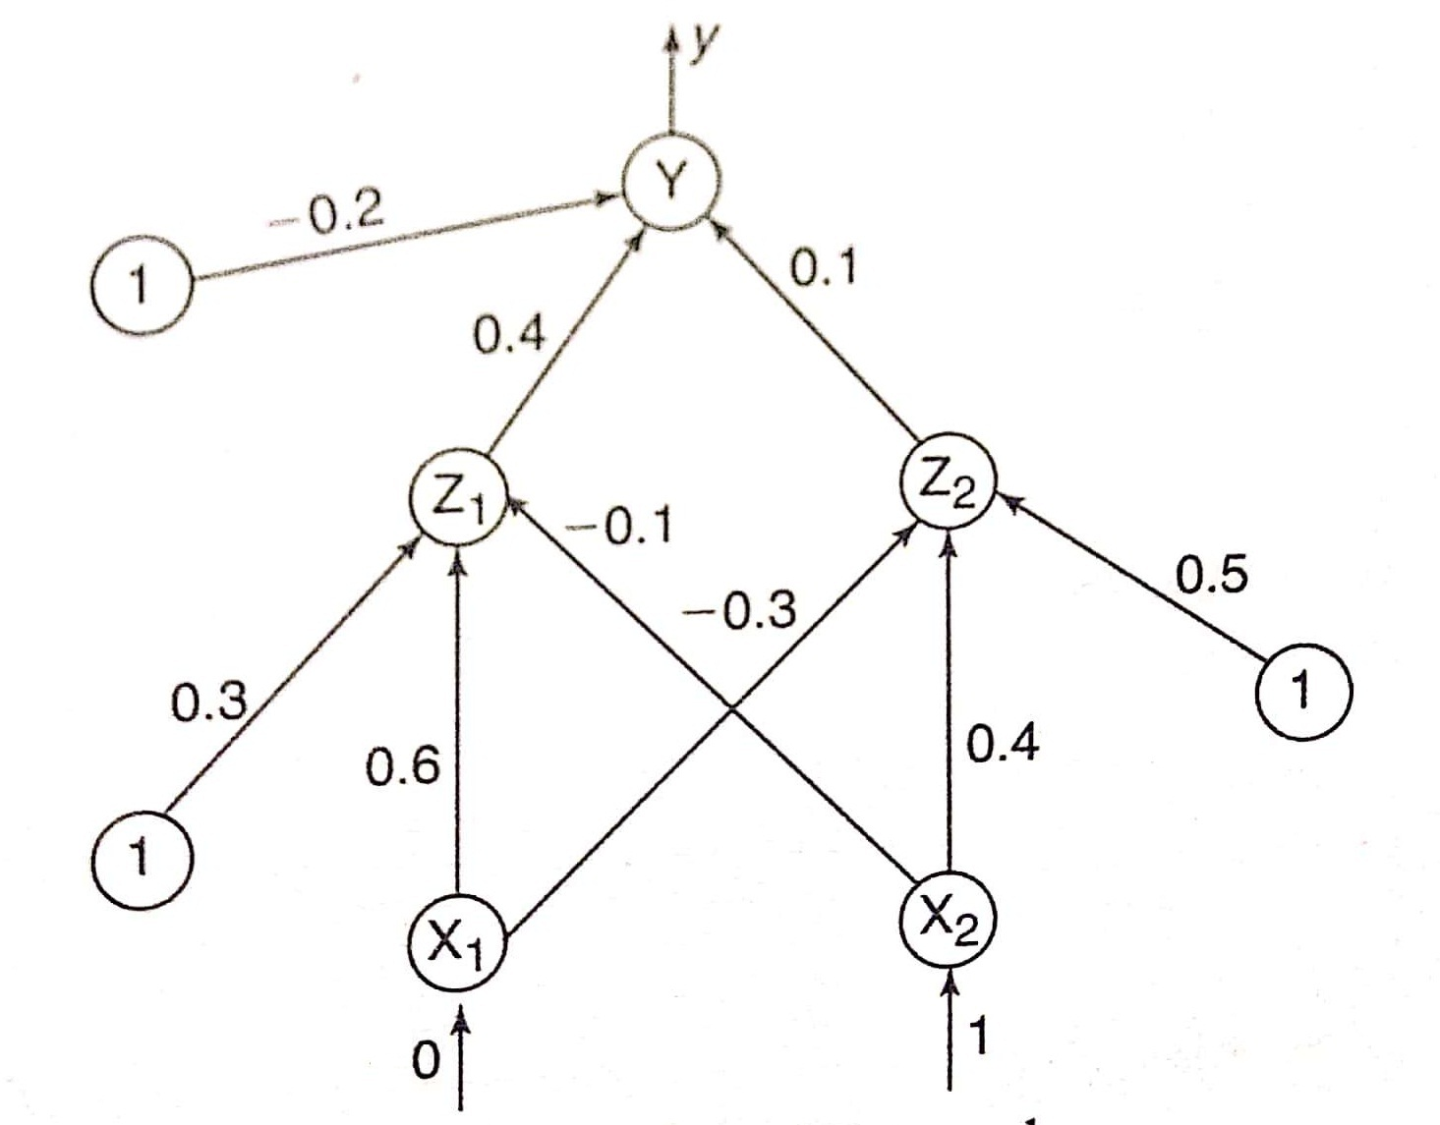

Slide 22
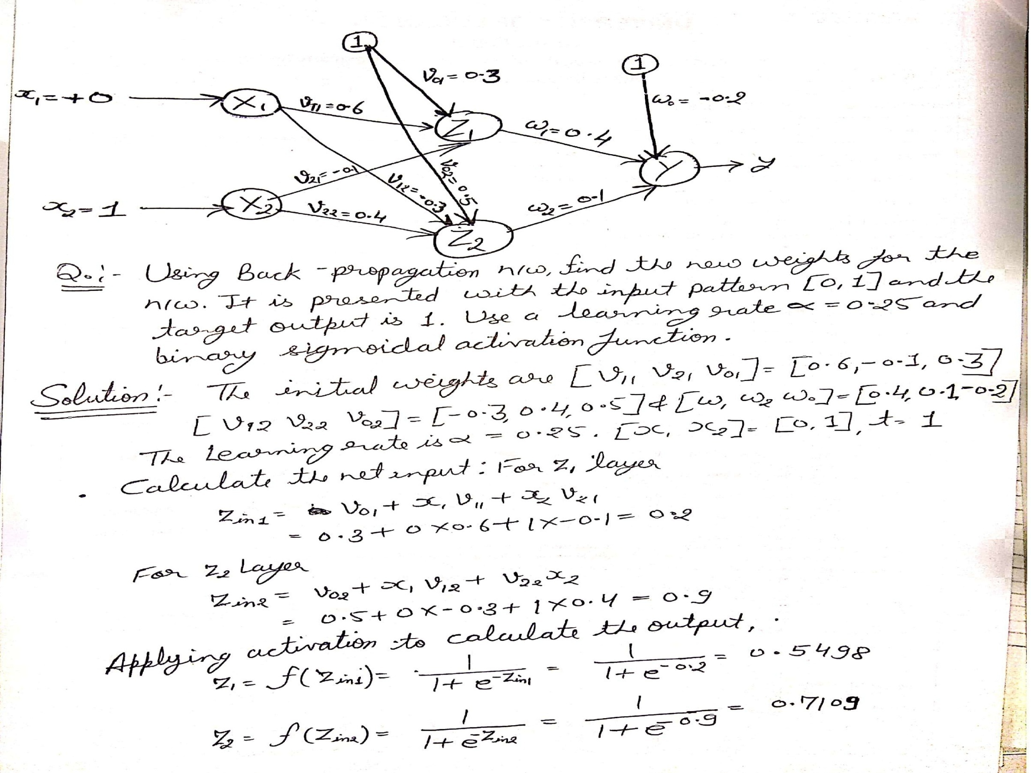

Slide 23
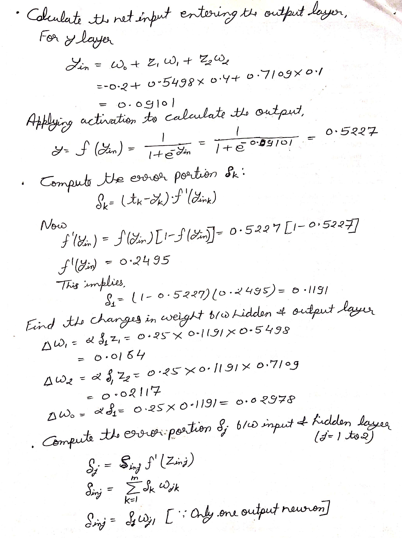

Slide 24
